Slide 1
CHEMISTRY OF TRANSITION AND INNER TRANSITION ELEMENTS
TRANSITION ELEMENTS

Slide 2
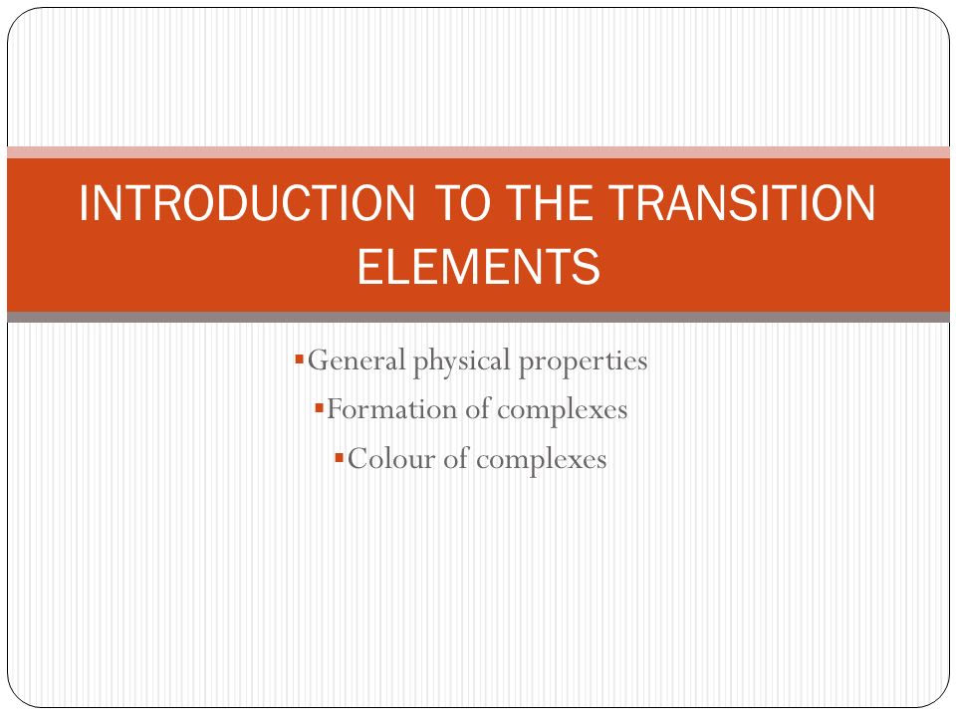

Slide 3
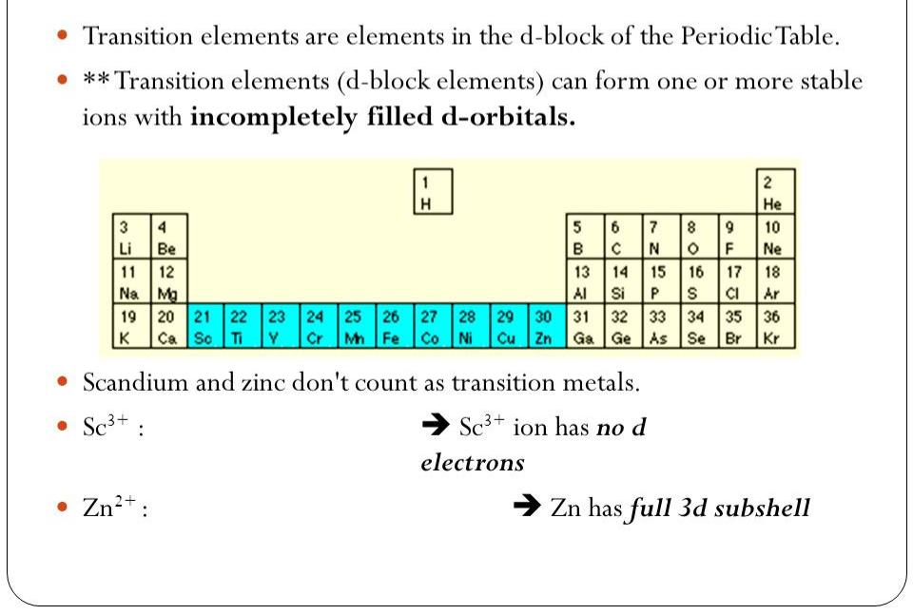
WHAT ARE TRANSITION ELEMENTS

Slide 4
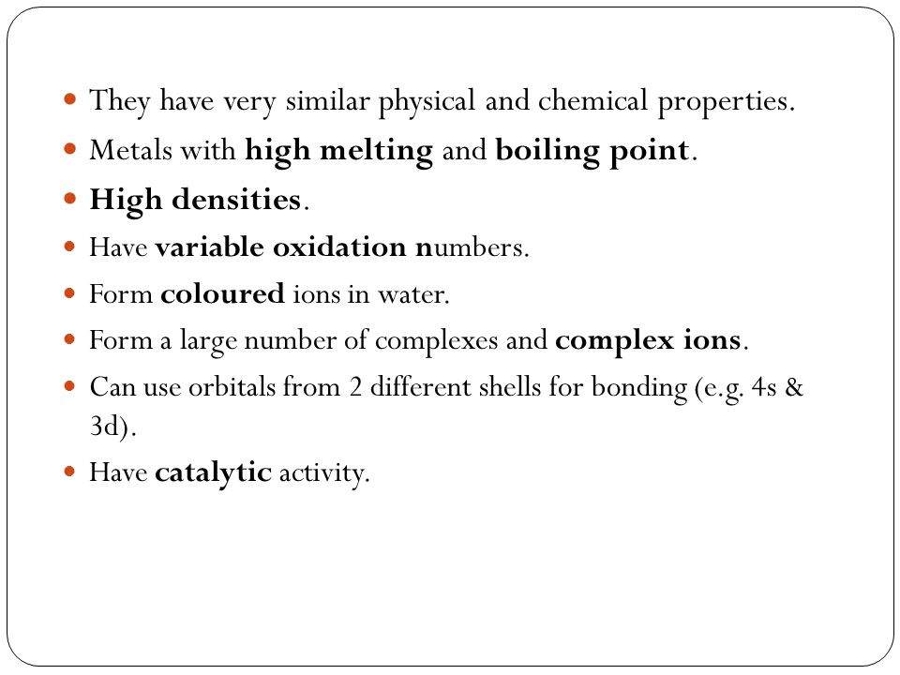

Slide 5
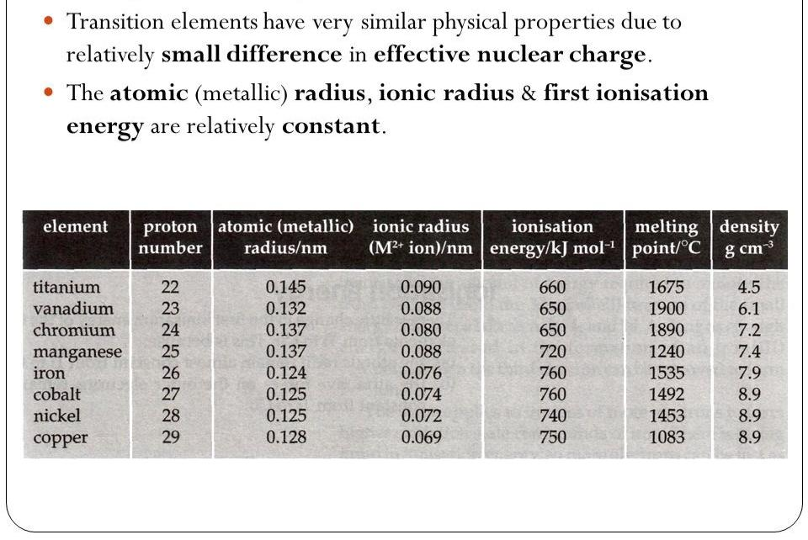
PHYSICAL PROPERTIES

Slide 6
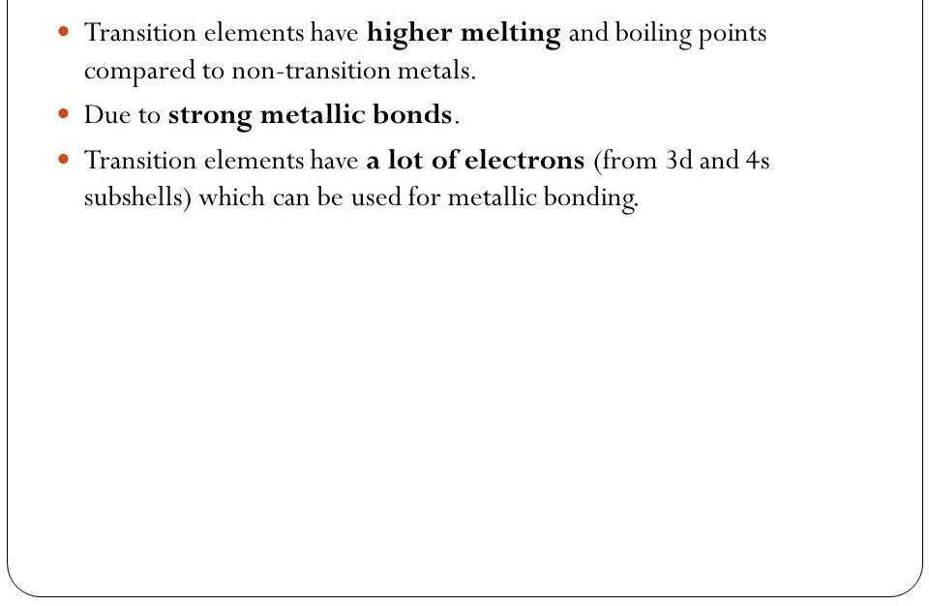
MELTING POINT

Slide 7
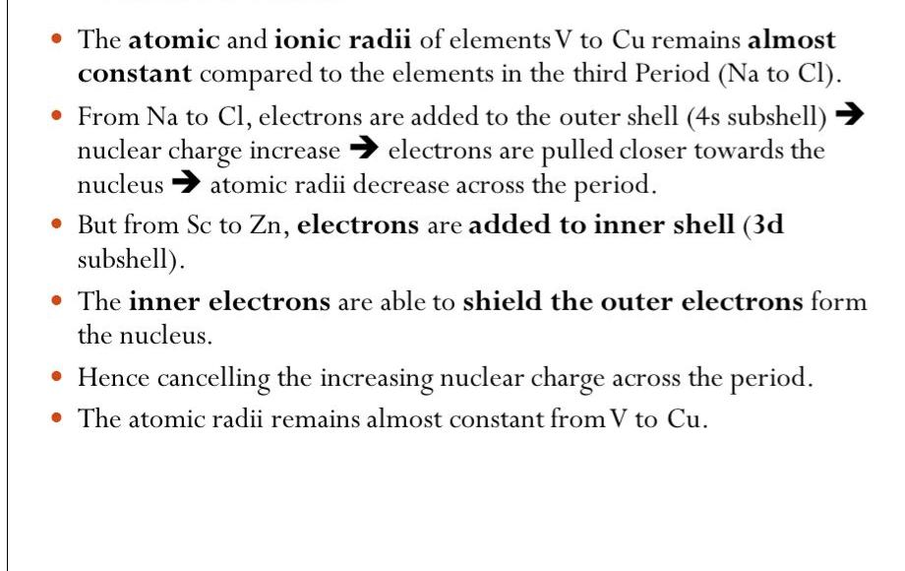
ATOMIC RADII

Slide 8
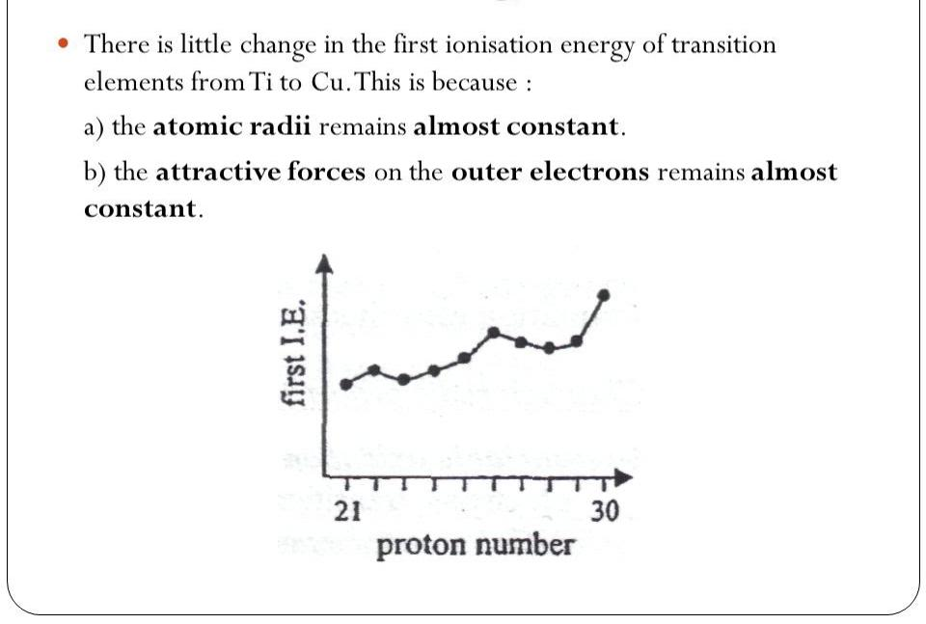
FIRST IONISATION ENERGY

Slide 9
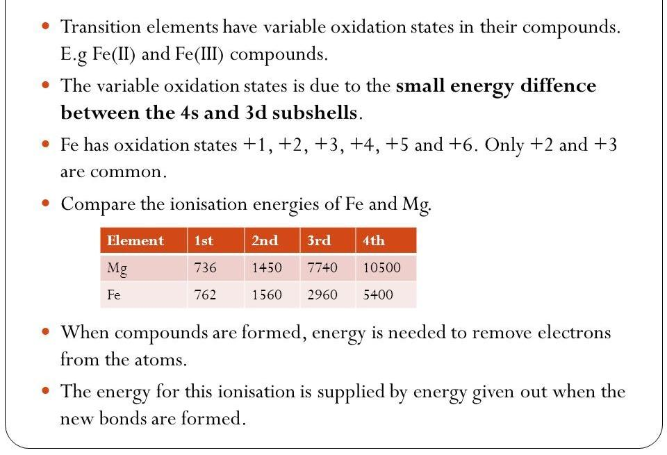
VARIABLE OXIDATION STATE

Slide 10
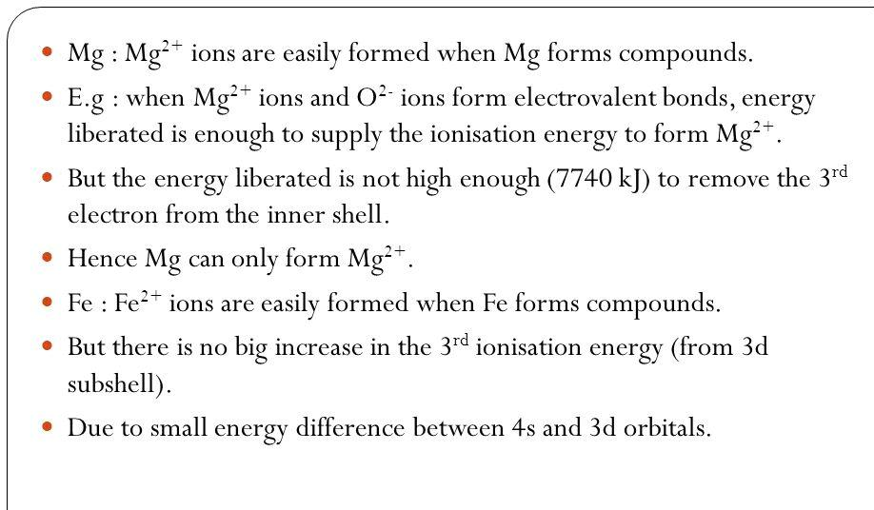

Slide 11
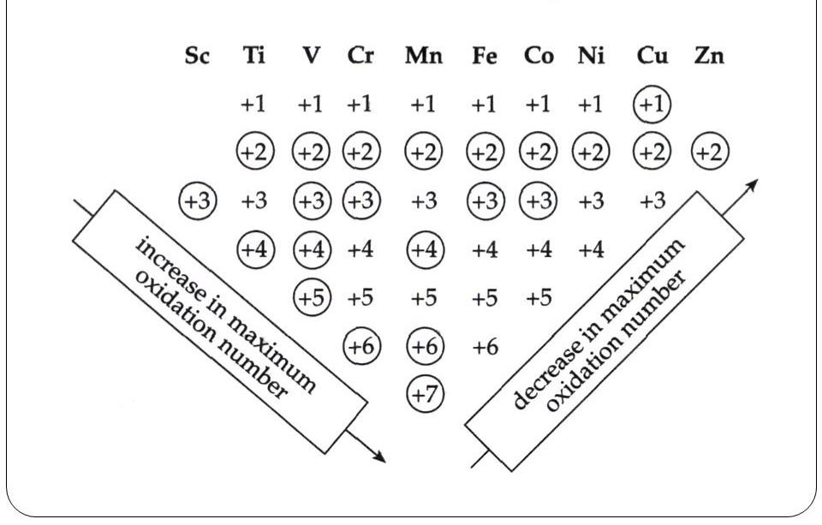
OXIDATION STATE IN COMPOUNDS

Slide 12
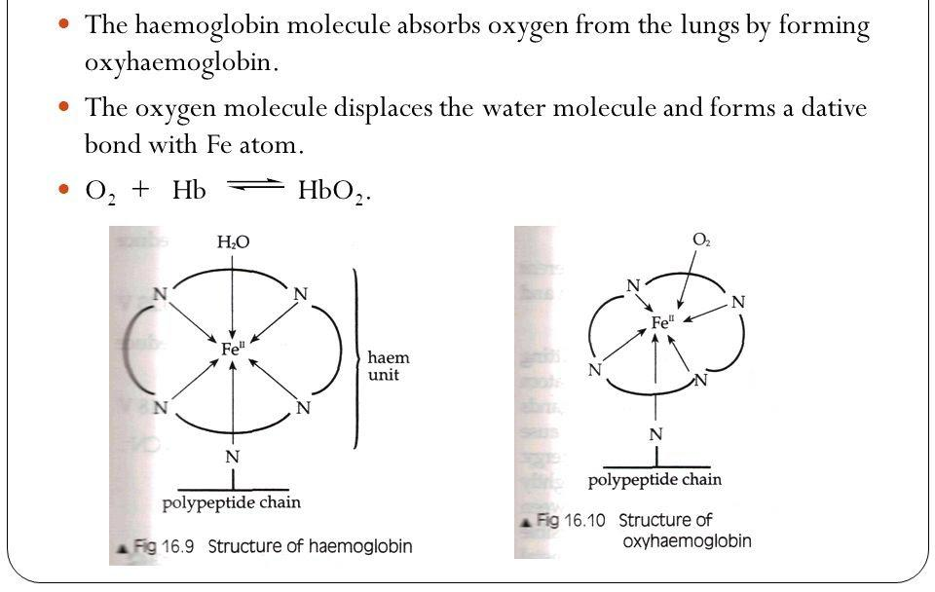
LIGAND EXCHANGE IN HEMOGLOBIN

Slide 13
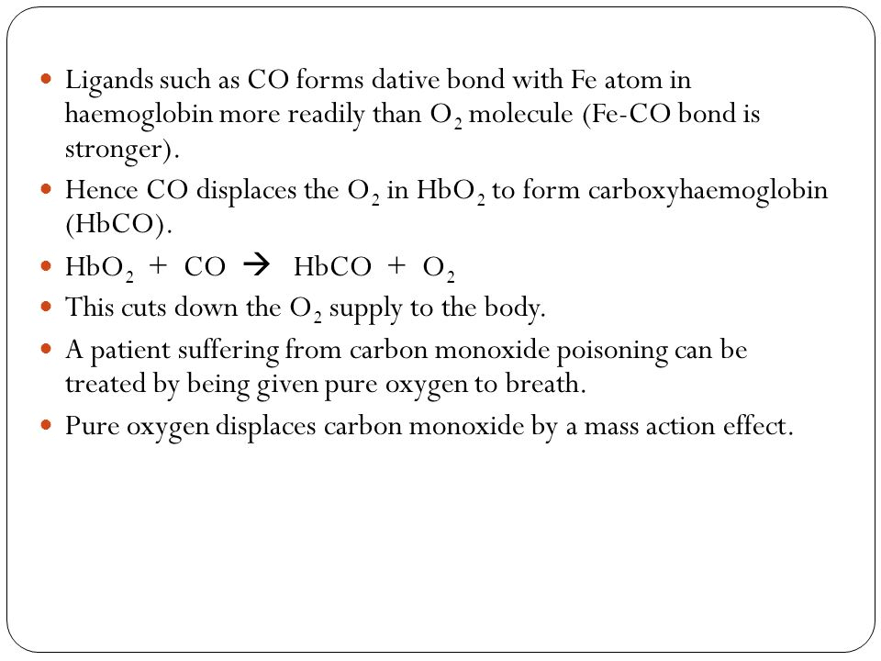

Slide 14
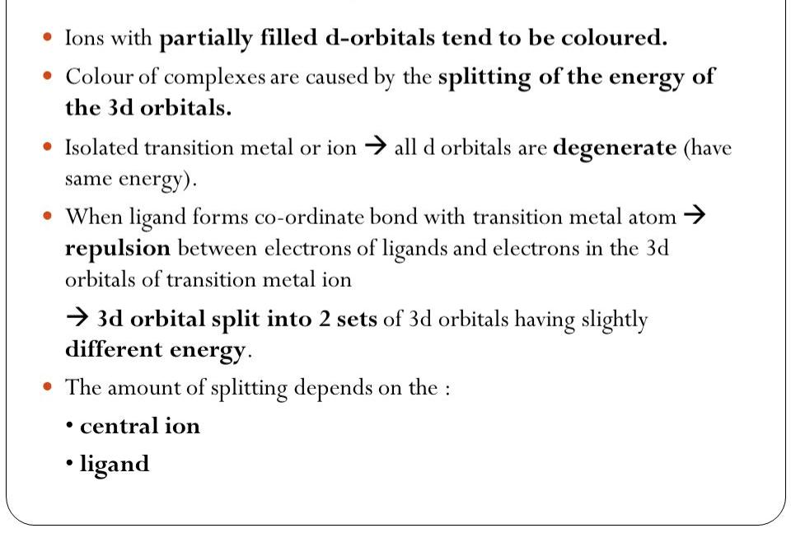
COLOUR OF COMPLEXES

Slide 15
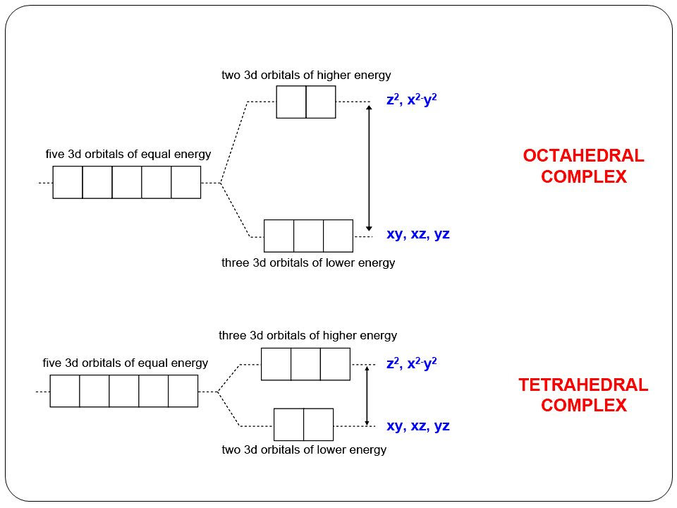

Slide 16
THANK
YOU 🙏

